Slide 1
Communication Skills for Engineers (COMM 402-EC10) Week 5 – Session 9
Prepared by Stefany Salemeh

Slide 2
Parts of the Informative Speech
Introduction:
Attention grabber
Introduce the topic
Establish credibility
Relate to audience
Central idea (preview the body of the speech)
Body:
Develop each main point by itself
Use credible supporting materials (examples, statistics, testimony).
Conclusion:
Reinforce the central idea
Signal the end of the speech
End with a quote, refer to the introduction, or make a dramatic statement

Slide 3

Use connectives to join one thought to another and indicate the relationship between them.
Transitions: A word or phrase that indicates when a speaker has finished one thought and is moving on to another.
Now that we have… we will discuss
Keeping these points in mind… let’s return to…
Internal Previews: Lets the audience know what the speaker is going to discuss next.
- We’ll look first at… and second at…
Internal Summaries: Summarizes the speaker’s preceding point or points.
In short,…
Let’s pause for a moment to summarize what we have found so far. First,…

Slide 4

Signposts: very brief statements that…
1. Indicate exactly where you are in the speech.
a. Numerical: The first cause… The second cause… The final cause…
b. Questions: You ask a question and then answer it to transition to the other main point.
2. Focus attention on key ideas:
- Be sure to keep in mind…
- This is crucial to understanding the rest of the speech…
- Above all, you need to know….

Slide 5
Solar energy is becoming more widely used in cities. It reduces dependence on fossil fuels and lowers carbon emissions. The system works by using photovoltaic panels to capture sunlight and convert it into electricity. Energy can also be stored in batteries for use when sunlight is not available.

Slide 6
To understand why solar energy is being more widely used in cities, let’s look at how these systems function. First, it reduces dependence on fossil fuels and lowers carbon emissions which makes it environmentally sustainable. Next, let’s examine how the technology actually works. The system works by using photovoltaic panels to capture sunlight and convert it into electricity. Finally, it is important to note that energy can also be stored in batteries for use when sunlight is not available.

Slide 7

Outline

Slide 8
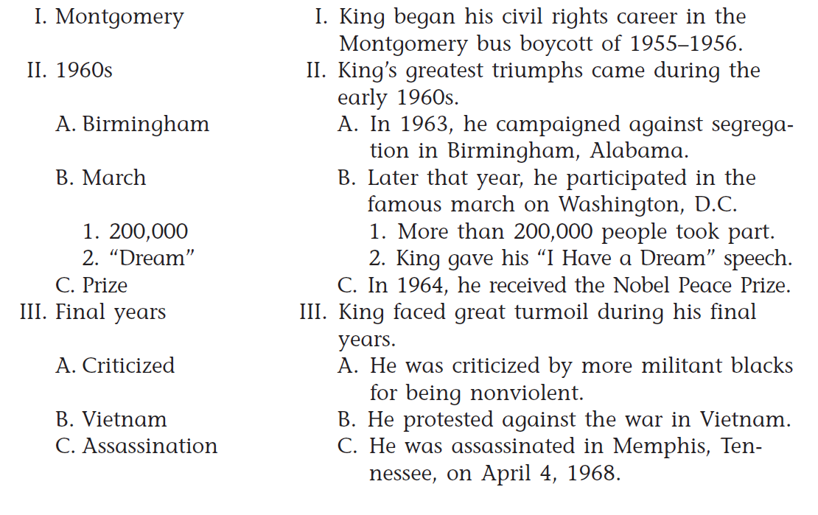


Compare both outlines:

Slide 9

What is the Preparation Outline?
It is a detailed and full-sentence version of your speech.
It includes:
- Specific purpose and the central idea
- Introduction
- Body (2-5 main points and at least 2 subdivisions for each point (supporting material))
- Transitions
- In-text citations and references (IEEE)

Slide 10
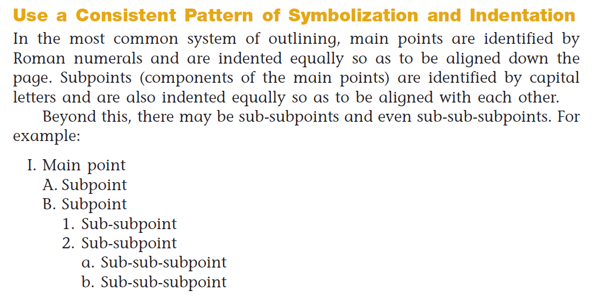

Slide 11
Using Sources
Don’ts
Do’s
Don’t copy-paste info from your sources.
Don’t plagiarize. Refer to your syllabus to understand the consequences of doing so.
Don’t be a smarty-pants and think you can cheat.
Rephrase and explain how it supports your main point.
Use quotation marks if your directly quote.
Use in-text citations and have a reference page.

Slide 12

Common Mistakes to Avoid
Vague points or weak support
Missing transitions
Incomplete or incorrect references
Sloppy formatting or structure
Plagiarism and use of AI

Slide 13
Check out the word document to see an example of how your outline should look like.

Slide 14
Format:
- Use Times New Roman, 12, double-spaced.
- Include your names, the date, the code of the class, and title of assignment.
- Use full and complete sentences.
- Use in-text citations and provide a reference page using IEEE.
- Do not add a cover page, a header, nor any pictures.

Slide 15
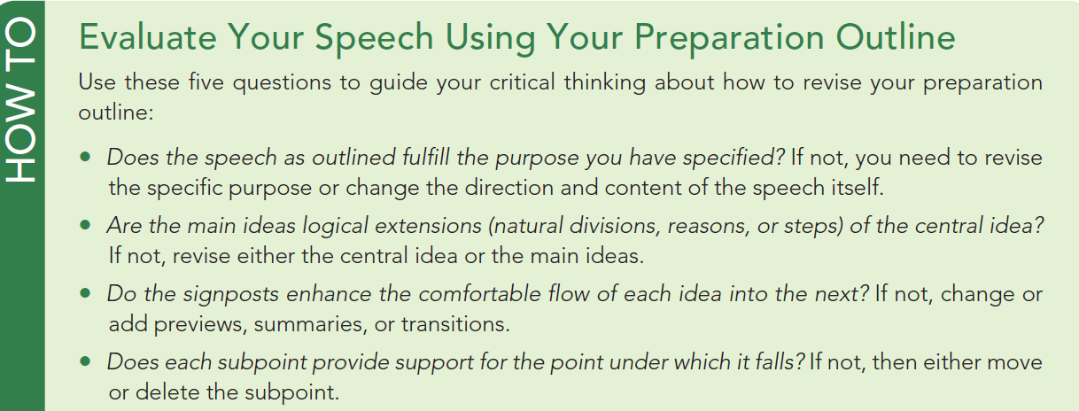

Slide 16

Editing your speech and revising as you rehearse:
Review your specific purpose (Too detailed? Too broad? Will go over the time limit?
Consider your audience!
Keep only the best supporting details.
Look at your introduction and conclusion.
Practice! Present in front of friends, family members, or classmates.

Slide 17
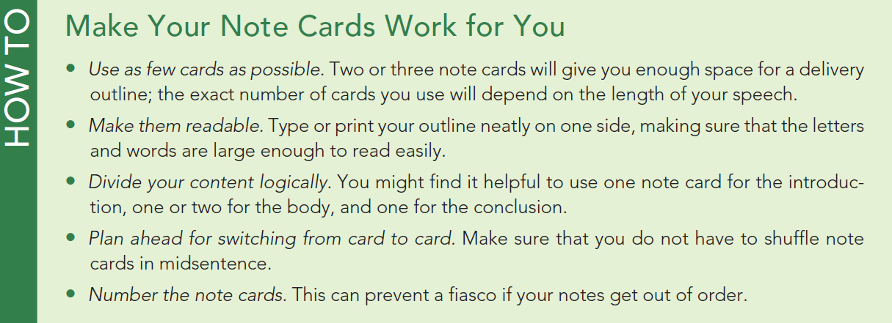

Slide 18
References
Lucas, S. E. (2020). The art of public speaking (13th ed.). McGraw-Hill Education.
Beebe, S. A., & Beebe, S. J. (2015). Public speaking handbook (4th ed.). Pearson.

